Slide 1
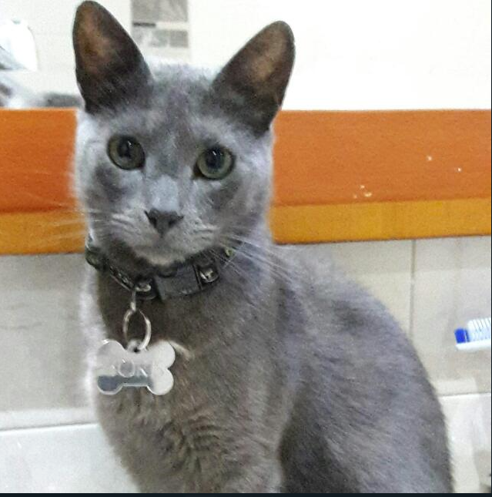
Boris
Is trying to do a booking cause he want to eat whit his family
USER EXPECTATIONS
Be sure he select the correct number of folks in the reservation.
Understand easily the booking’s options
ENTER WEBSITE
SELECT & CUSTOMIZE
DETAILS
PAY
DOING
Open Lemon web
Find make a booking option easy
Locate all the bookings possibilities
Set amount of people
Set date & time
Watch price clearly
Watch any possibilities
Think
I'm exciting to taste this famous place
Aaaa – could I locate easily all the booking possibilities
What happen here?, where I can choose de date & hour
May I choose my credit young card ?
SAYING
Coool..I can go with my family
Where I can choose VIP booking
Where I can choose the day and hour
I'm not sure if my credit young card work in this case
FEEL
OPPORTUNITIES
We will have the option to add booking options depending on customer's preferences
TO DO
Add booking options with their hour and date

